Slide 1
Credit Risk Model
Project by
Naga Jyothi Muvva
Sai Niketh Mulakala
Anzar Aslam shah
Group - 07

Slide 2
Executive Summary
Objective:
We have to outline an aggressive and conservative strategy that allows lenders, here credit card companies i.e., Amex to optimize lending decisions, which leads to a better customer experience and sound risk strategy, based on revenue generated.
The XGBoost algorithm formulates a better risk strategy based on its performance metrics when compared with the performance of the Neural Network algorithm.
 | Train |  |  | Test 1 |  |  | Test 2
 | Threshold | Default Rate | Revenue | Threshold | Default Rate | Revenue | Threshold | Default Rate | Revenue
Conservative Strategy | 0.4 | 1.909 | 85242$ | 0.4 | 2.081 | 18262$ | 0.4 | 2.075 | 18306$
Aggressive Strategy | 0.7 | 7.245 | 96033$ | 0.7 | 7.421 | 20592$ | 0.7 | 7.508 | 20658$

Slide 3
Data
The data has 91783 unique customers.
Dataset includes 13 months of historical data including credit card applications.
By looking at these values most of the customers have 13 months of historical data from April 2018 originations.
Category | # of Observations | Default Rate
All Applications | 91783 | 24.84%
Applications with 13 months of historical data | 77348 | 22.94%
Applications with 12 months of historical data | 2115 | 37.87%
Applications with 11 months of historical data | 1159 | 44.08%
Applications with 10 months of historical data | 1329 | 46.57%
Applications with 9 months of historical data | 1278 | 43.58%
Applications with 8 months of historical data | 1169 | 45.08%
Applications with 7 months of historical data | 1046 | 41.49%
Applications with 6 months of historical data | 1109 | 41.29%
Applications with 5 months of historical data | 933 | 39.44%
Applications with 4 months of historical data | 938 | 43.07%
Applications with 3 months of historical data | 1158 | 35.75%
Applications with 2 months of historical data | 1217 | 31.22%
Applications with 1 months of historical data | 984 | 33.13%

Slide 4
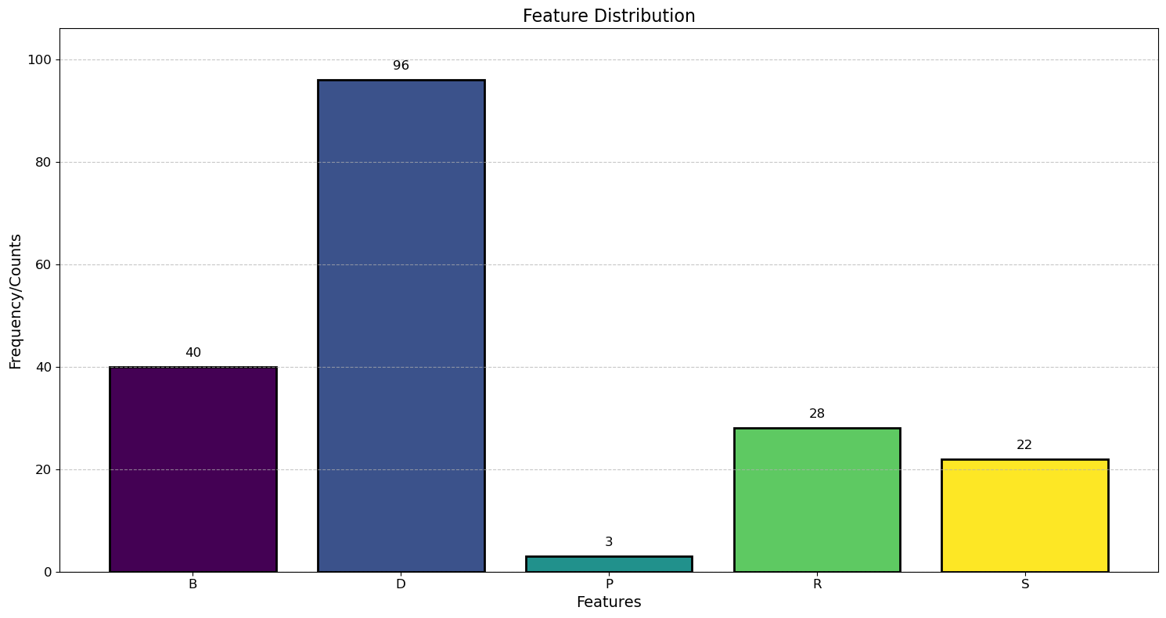
Features
Raw data includes different categories like Delinquency, Balance, Risk, Spend and Payment.
Category | # of features
Delinquency | 96
Balance | 40
Risk | 28
Spend | 22
Payment | 3

Slide 5
Feature Engineering
Category | # of features
Delinquency | 471
Balance | 200
Risk | 142
Spend | 106
Payment | 15
Numerical features are defined through aggregate functions like mean, min, max, last values of 12 months.
Categorical features are defined through Response rate in last 12 months.
Top 5 features with highest SHAP values in the best XGBoost model:
Feature | Min | 1st Percentile | 5th Percentile | Median | 95th Percentile | 99th Percentile | Max | Mean | %Missing
P_2_last_12 | -3.915x10^-1 | -0.080750 | 0.135433 | 0.694409 | 0.978846 | 1.006341 | 1.009994 | 0.643250 | 0.0
B_1_last_12 | -3.610x10^-1 | 0.000490 | 0.002091 | 0.031745 | 0.655259 | 1.052372 | 1.323996 | 0.135610 | 0.0
B_4_last_12 | 4.238x10^-7 | 0.000825 | 0.003851 | 0.091879 | 0.689480 | 1.103397 | 3.483551 | 0.191710 | 0.0
B_2_last_12 | 2.317x10^-6 | 0.001756 | 0.008880 | 0.813630 | 1.008452 | 1.009707 | 1.009999 | 0.596552 | 0.0
D_41_last_12 | 1.859x10^-7 | 0.000130 | 0.000608 | 0.006009 | 0.648679 | 1.562106 | 8.988807 | 0.101419 | 0.0

Slide 6
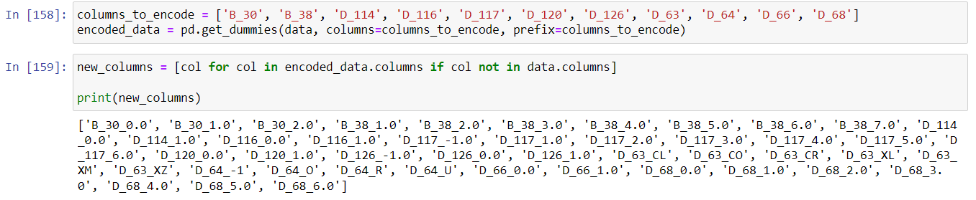
Data Processing / One-Hot Encoding
Dataset includes 11 categorical features with different categories.
After one hot encoding, 45 new features were created.

Slide 7
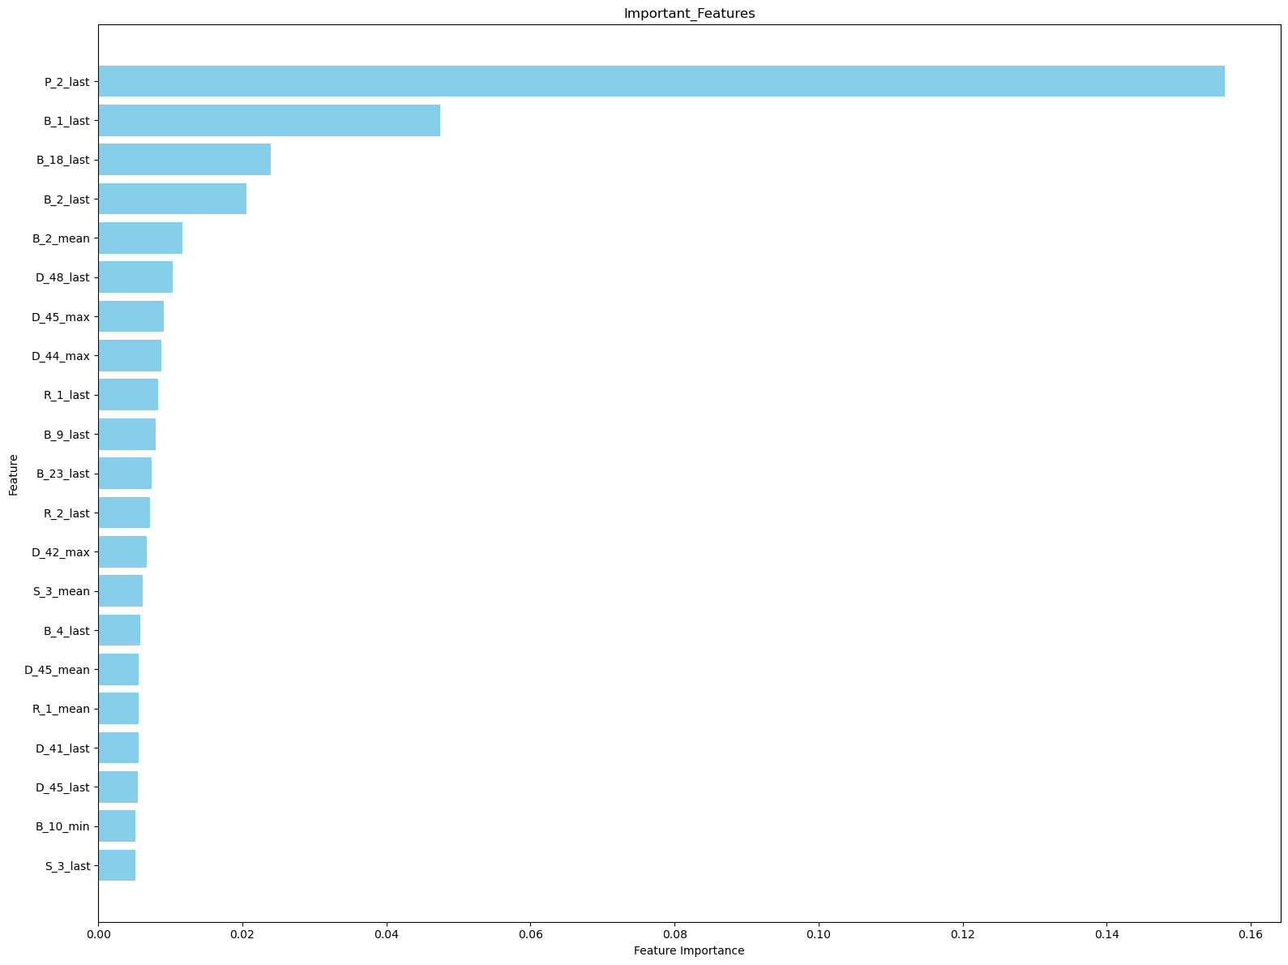
Feature Selection
After running Xgb models using the training dataset(70% from split), important features were selected which has feature importance greater than 0.5%.
These selected important features were used to run the grid search.
Category | # of features | # Selected
Delinquency | 471 | 7
Balance | 200 | 8
Risk | 142 | 3
Spend | 106 | 2
Payment | 15 | 1

Slide 8
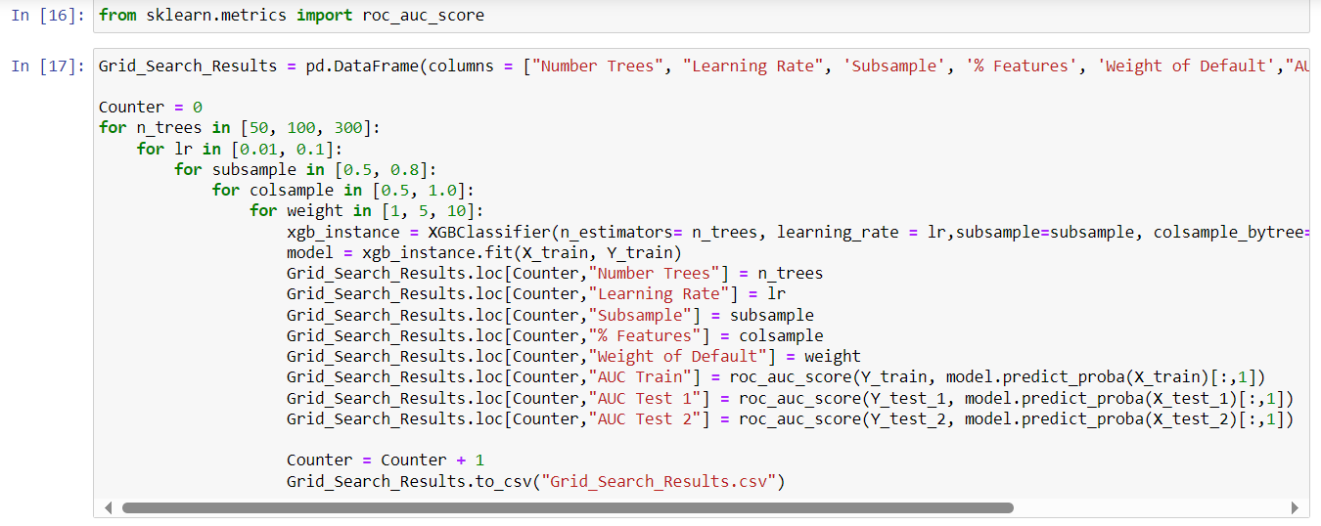
XGBoost - Grid Search
The following parameters are used for the best result
Number of trees: 50, 100, and 300
Learning Rate: 0.01, 0.1
Percentage of observations used in each tree: 50%, 80%
Percentage of features used in each tree: 50%, 100%
Weight of default observations: 1, 5, 10
Based on # the parameters, 72 models are trained.

Slide 9
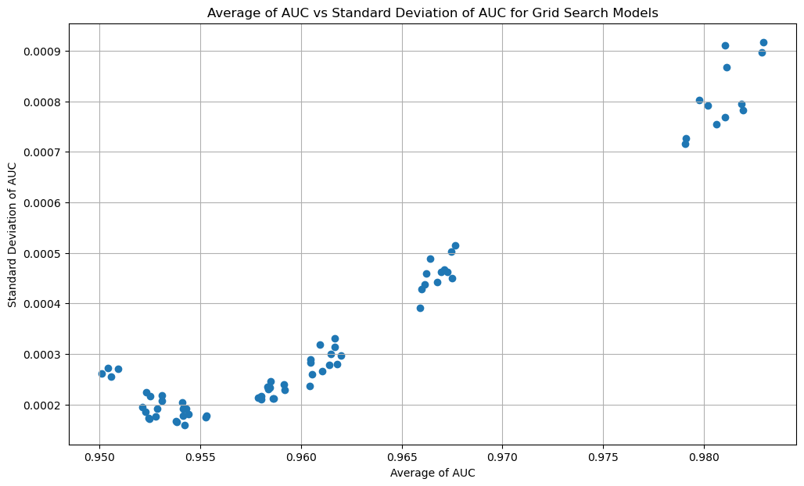
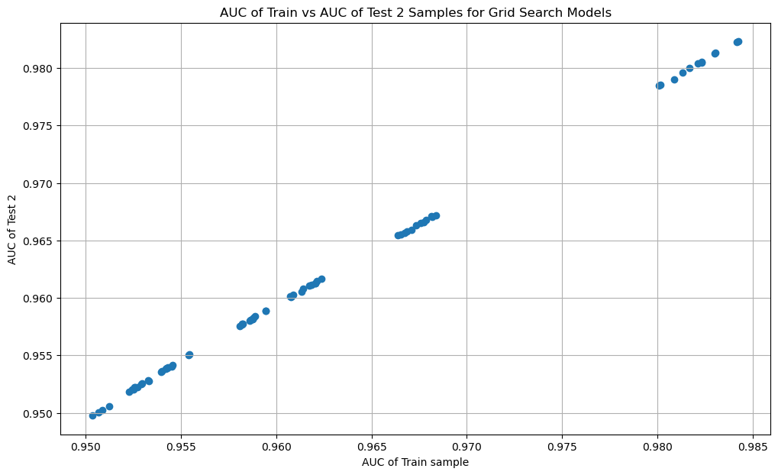
XGBoost - Grid Search
We selected the model with the highest AUC and minimal difference in variance between the training and test datasets to enhance the model’s predictive capability.
Train sample vs test 2 sample gives the highest AUC value. Thus, selecting it gives the best XGBoost model.

Slide 10
XGBoost – Final Model
Parameters | Values
Number of trees | 300
Learning rate | 0.1
Subsample | 0.5
% Features | 1
Weight of default | 1
Area Under Curve
Train | 0.98
Test 1 | 0.98
Test 2 | 0.98

Slide 11
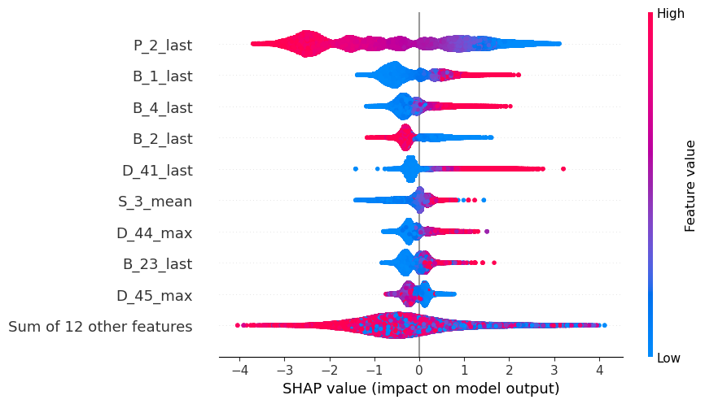
XGBoost – SHAP Analysis
Top 5 Important Features based on SHAP Analysis
P_2_last
B_1_last
B_4_last
B_2_last
D_41_last
Here P_2_last has a negative impact on prediction(negatively affect the output).
Most of the other features have a positive impact on prediction.

Slide 12
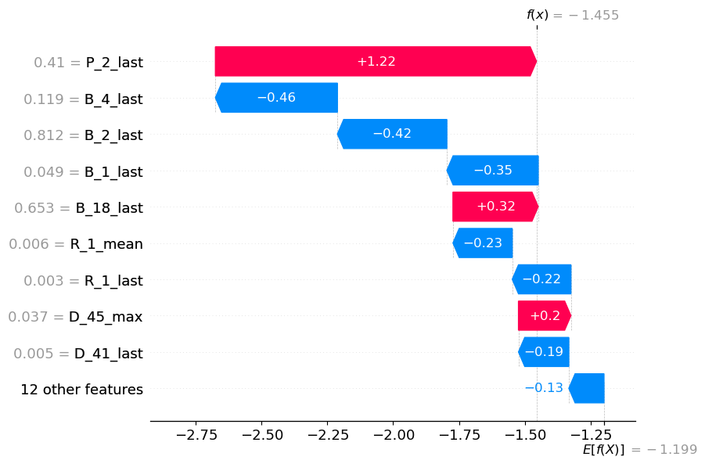
XGBoost – SHAP Analysis
The sum of all SHAP values will be equal to E[f(x)] — f(x).
SHAP values are valid for the 150th index observation only.
P_2_last gives the most positive contribution to the output.
B_4_last, B_2_last, B_1_last are showing negative impact on the output.

Slide 13
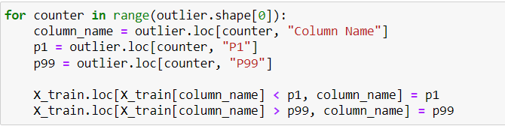
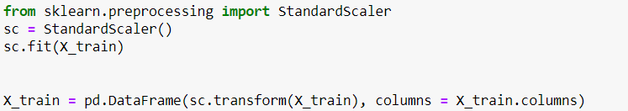

Neural Network – Data Processing
Outlier treatment
We modified the outliers to the 99 percentile value
after checking our data using normalization
Normalize data
we have normalized the data using the standard scaler function from
the sklearn library in Python
Replace missing values
All the missing values were replaced with 0.
Grid search
Hyperparameters were selected after data was processed with grid search and the model was trained after the data processing.

Slide 14
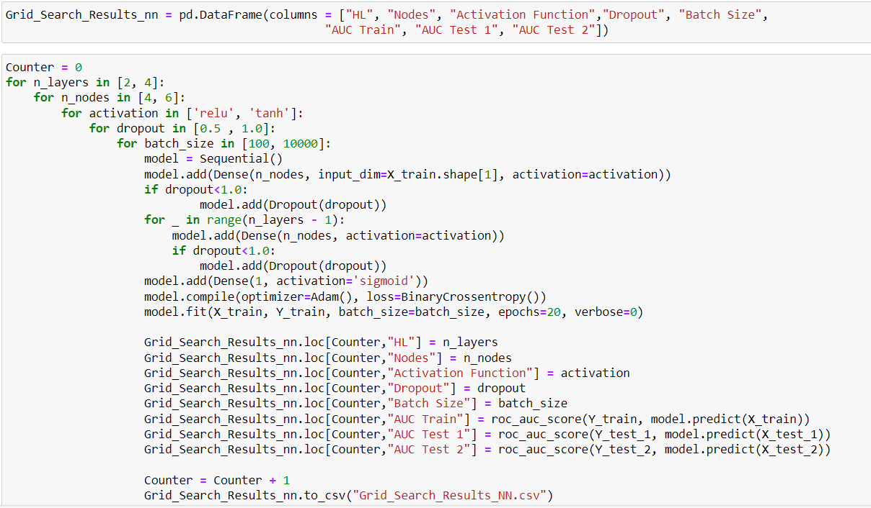
Neural Network - Grid Search
Observations:
32 models were trained.
Adjacent code is used for both 2 and 4 hidden layers.
Model details:
Number of hidden layers: 2, 4
# nodes in each hidden layer: 4, 6
Activation function for hidden layers: ReLu, Tanh
Dropout regularization for hidden layers: 50%, 100% (no dropout)
Batch size: 100, 10000

Slide 15
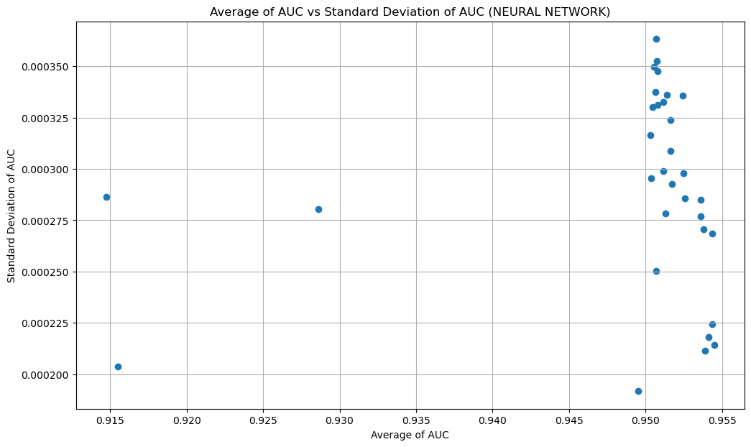
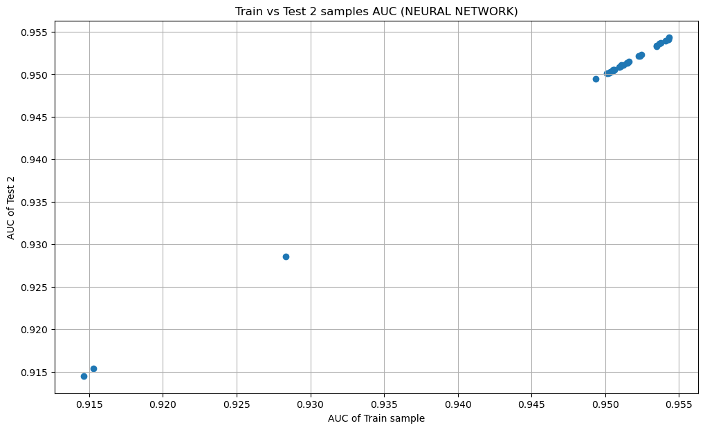
Neural Network - Grid Search
We selected the model with the highest AUC and minimal difference in variance between the training and test datasets to enhance the model’s predictive capability.
Train sample vs test 2 sample gives the highest AUC value. Thus, selecting it gives the best Neural Network model.

Slide 16
Neural Network – Final Model
Parameters | Values
No of layers | 4
No of nodes | 6
Activation | tanh
Dropout rate | 1
Batch size | 100
Area under curve
Train | 0.95
Test 1 | 0.95
Test 2 | 0.95

Slide 17
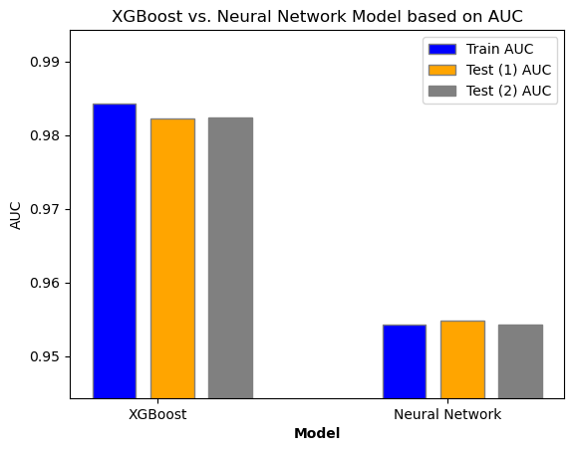
Final Model
The higher the AUC, the better the model is at predicting 0 classes as 0 and 1 classes as 1.
Highest AUC scores are observed on Train, Test 1 and Test 2 samples for XGBoost model.
So XGBoost model is the great choice for this dataset.

Slide 18

Strategy
We have chosen S_3_mean as the spending variable and B_2_mean as the balance variable.
We used the following formula to calculate the Revenue:
Revenue = $Sum of Balance Feature×0.02+Sum of Spend Feature×0.001$
Train |  |  | Test 1 |  |  | Test 2
Threshold | Default rate | Revenue | Threshold | Default rate | Revenue | Threshold | Default rate | Revenue
0.1 | 0.158 | 71714$ | 0.1 | 0.219 | 15378$ | 0.1 | 0.201 | 15387$
0.2 | 0.508 | 77612$ | 0.2 | 0.585 | 16629$ | 0.2 | 0.566 | 16643$
0.3 | 1.055 | 81747$ | 0.3 | 1.164 | 17500$ | 0.3 | 1.184 | 17558$
0.4 | 1.909 | 85242$ | 0.4 | 2.081 | 18262$ | 0.4 | 2.075 | 18306$
0.5 | 3.19 | 88705$ | 0.5 | 3.374 | 19009$ | 0.5 | 3.363 | 19055$
0.6 | 4.864 | 92215$ | 0.6 | 5.066 | 19765$ | 0.6 | 5.094 | 19819$
0.7 | 7.245 | 96033$ | 0.7 | 7.421 | 20592$ | 0.7 | 7.508 | 20658$
0.8 | 10.544 | 100472$ | 0.8 | 10.683 | 21548$ | 0.8 | 10.834 | 21633$
0.9 | 15.063 | 106005$ | 0.9 | 15.108 | 22720$ | 0.9 | 15.212 | 22797$
1 | 24.65 | 117286$ | 1 | 24.665 | 25132$ | 1 | 24.629 | 25178$

